Slide 1

House Price Prediction in King County, USA
Project Group 1
Yunfei Bai, Elena Melnichenko, Sateesh Puripanda, Abhishek Sinha

Slide 2
First Look
19 predictor variables to predict Housing Price, along with 21613 observations
15% of data is kept aside to be used for validation. Rest 85% data has been divided into 70:30 to train and test the model.
No missing values and duplicate records
Some parameters clearly do not affect prediction, e.g. id, longitude and latitude
Some parameters are likely to be cross correlated, e.g.
Sqft living/ Sqft living 15 (same with Sqft lot, evening, international)
In the confounding sets sqft_living and grade have high correlation with price than other variables.

Slide 3
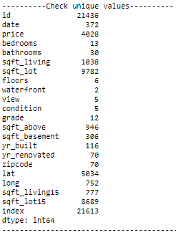
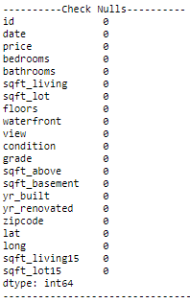
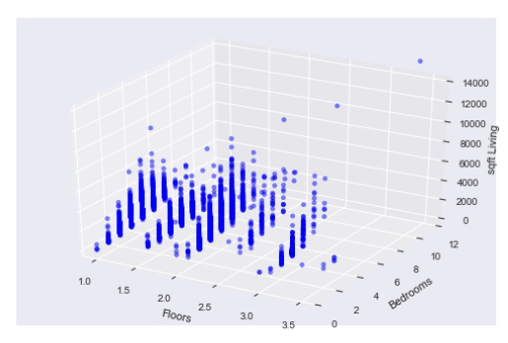
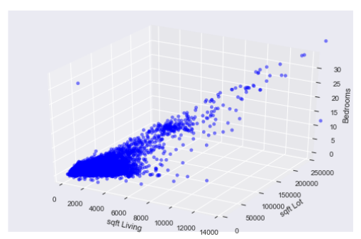
EXPLORING DATA
Missing values check
Converting categorical values to numerical
Excluding parameters that will not help for the model
Correlation between features

Slide 4
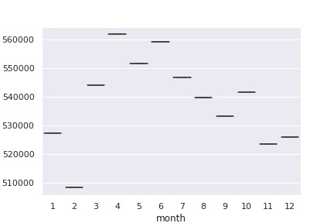
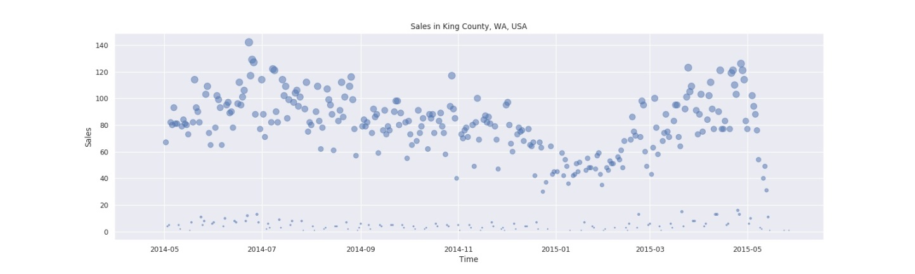
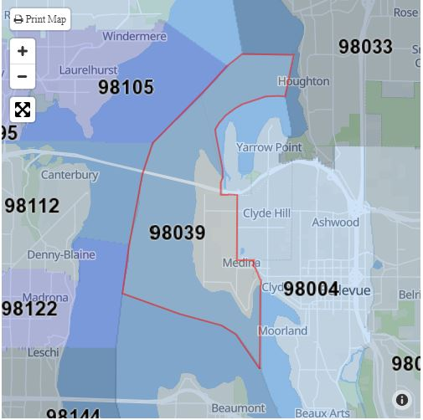
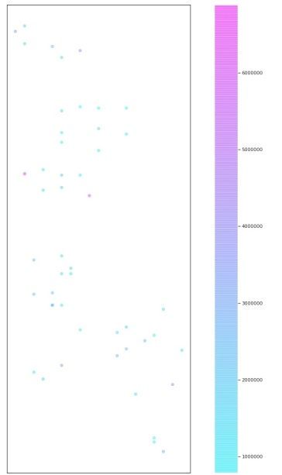
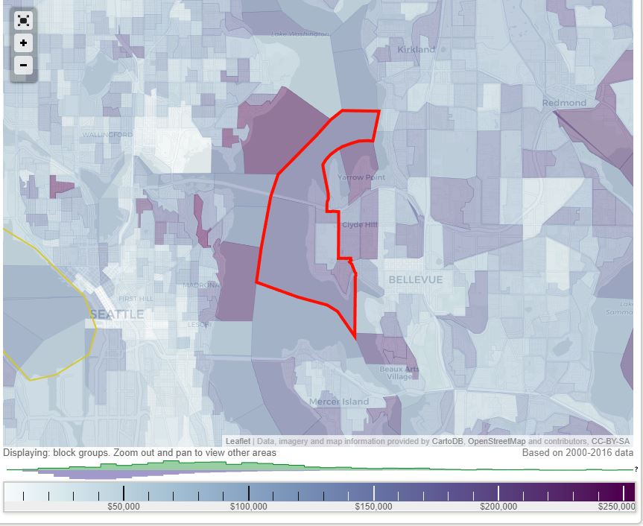

Time, Location, Money
House sale prices for King County between May 2014 and May 2015
(https://www.kaggle.com/harlfoxem/housesalesprediction)

Slide 5
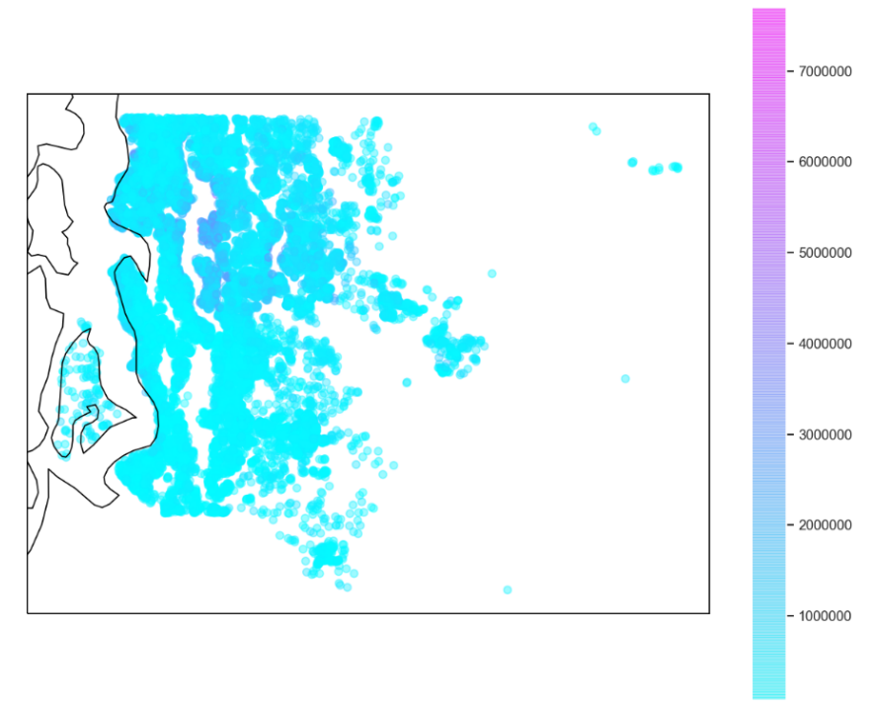
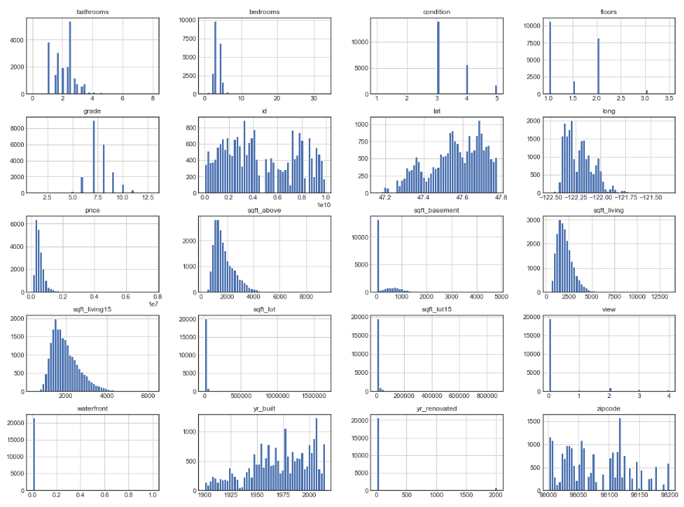

Descriptive Analysis
histogram

Slide 6
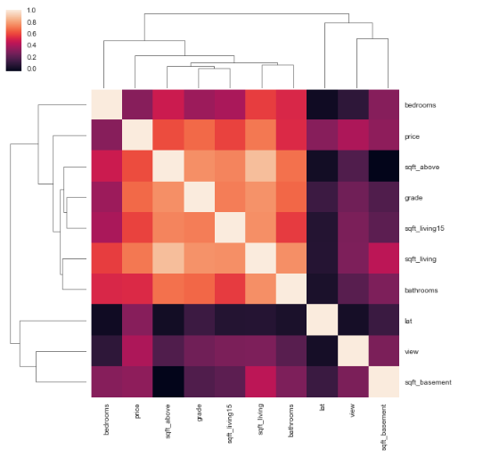
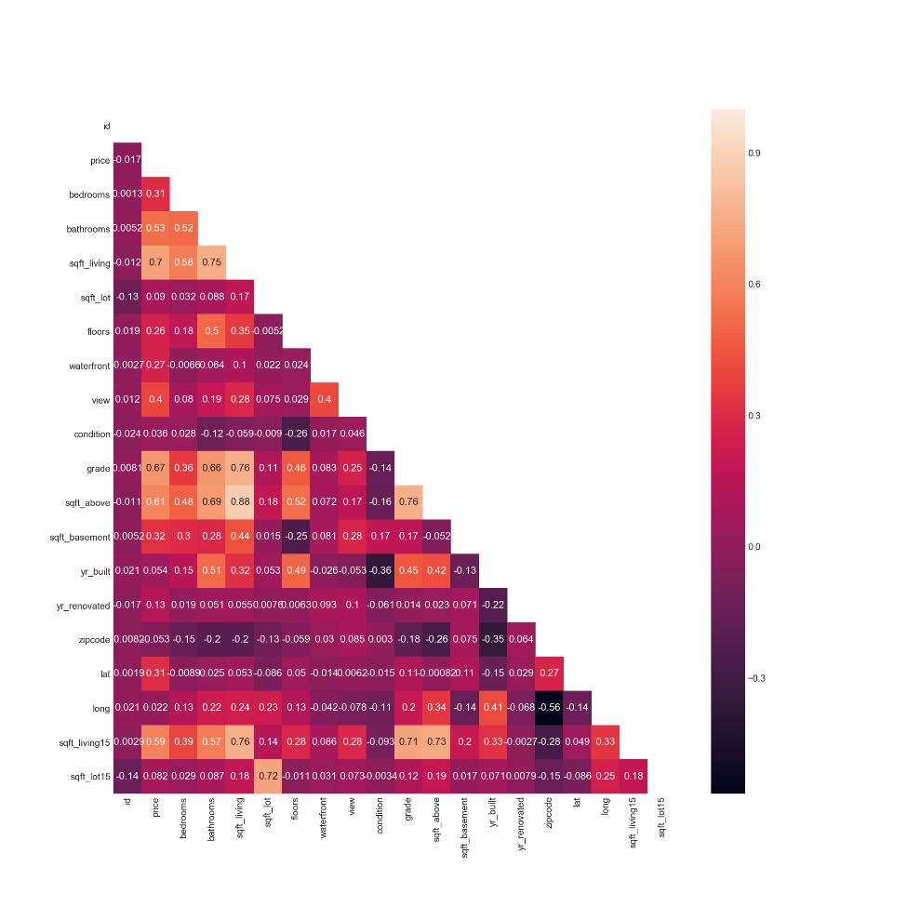
Descriptive Analysis
Correlation heatmap

Slide 7
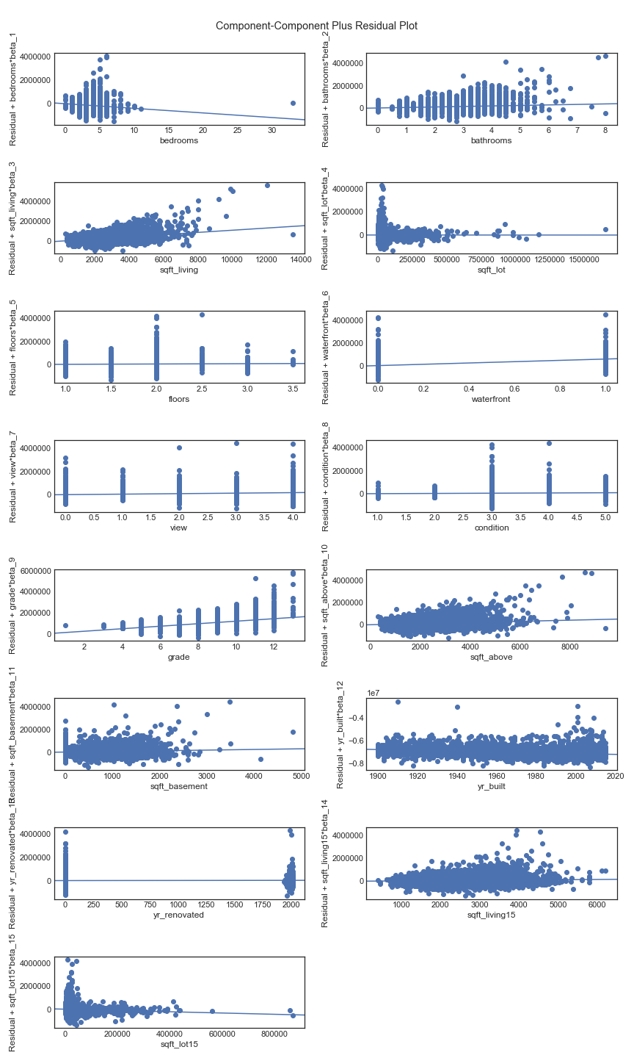
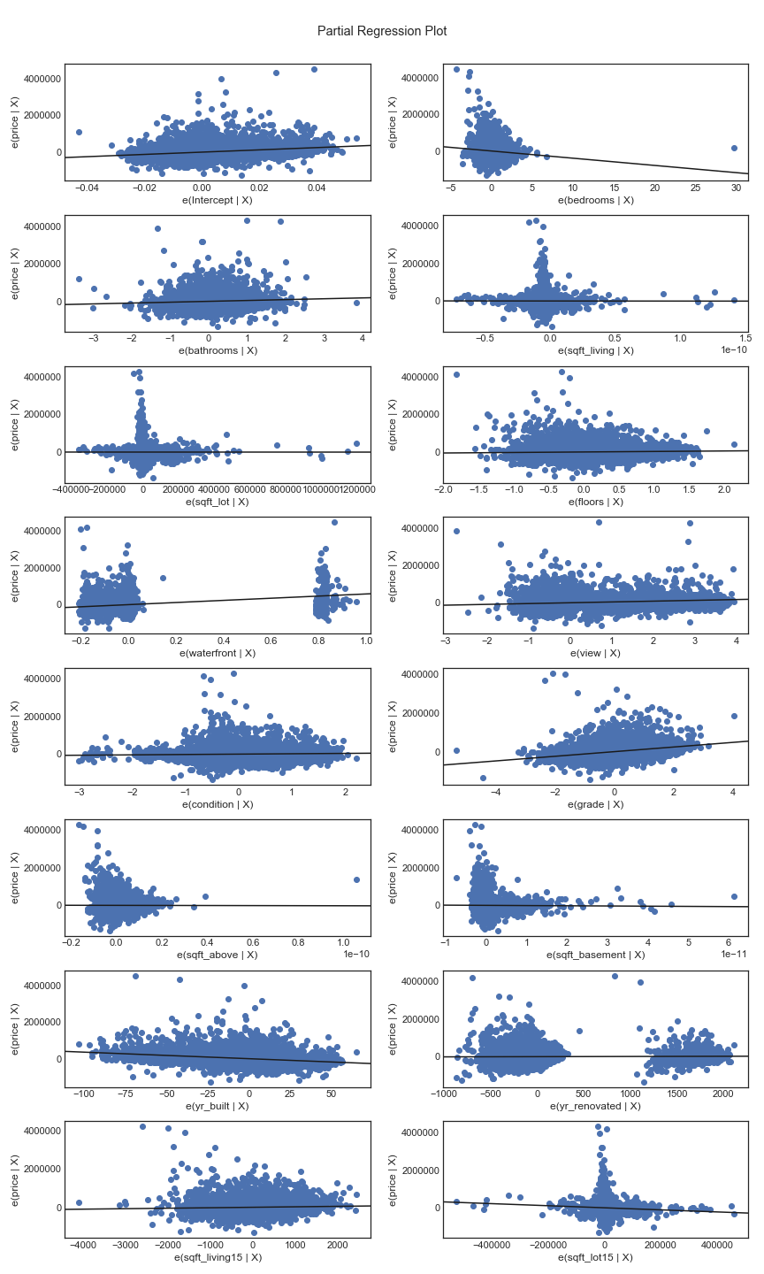
Feature Engineering
Numerical Variables:
Date => days since 1900-01-01
Bedrooms, bathrooms, sqft_living, sqft_lot, floors, waterfront, view, condition, grade, sqft_above, sqft_basement, yr_built, yr_renovated, sqft_living15, sqft_lot15
Categorical variables:
zipcode : since we have 70 distinct zipcodes in this King county dataset, we categorized it into 70 dummy variables.

Slide 8
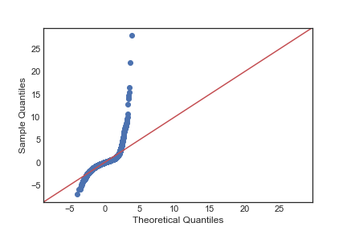
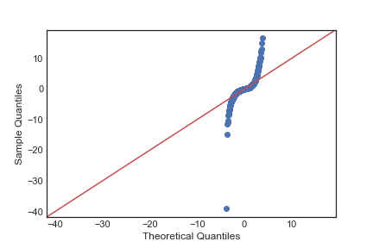
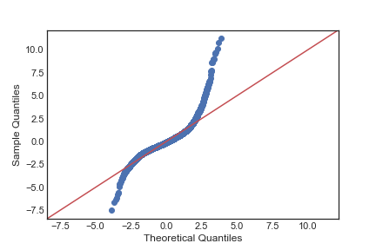
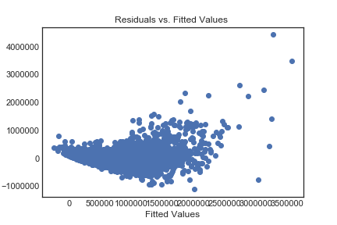
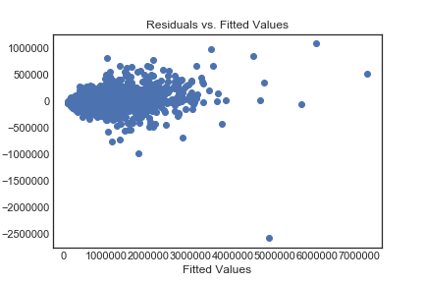
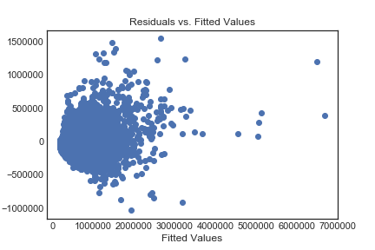
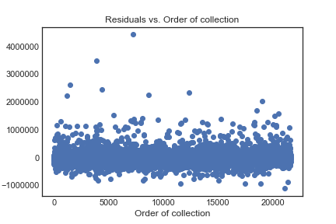
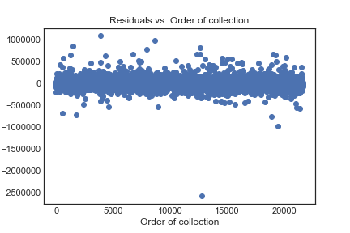
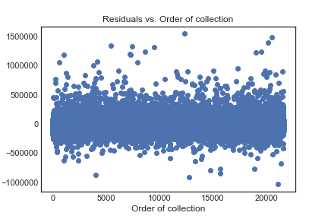
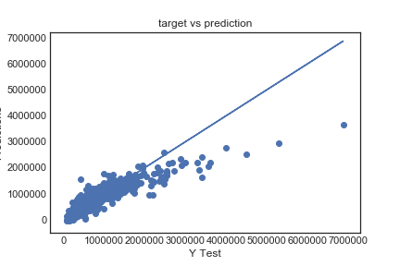
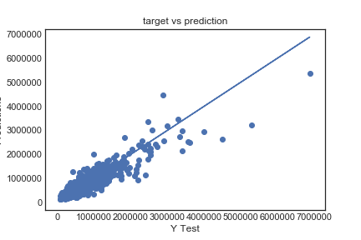
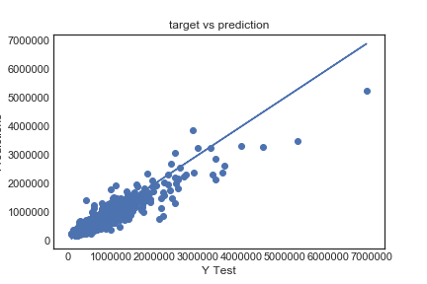
Prediction Model
 | Linear Regression | Random Forest Regression | Gradient Boosting Regression
normality plot
residual vs fitted value
residual vs order of collection
prediction vs target
Baseline score | Adj R squared: 0.80 RMSE: 170731 | Adj R squared: 0.84 RMSE: 152372 | Adj R squared: 0.84 RMSE: 153156
First we feed features into multi-linear regression model
Then we feed data into another two algorithms, Random Forest Regression Model and Gradient Boosting Regression Model.
All three algorithm we used “backward elimination + cross validation” to get the best model.
Gradient Boosting Regression handed the outliners pretty well
A
B
Both Random Forest Regression and Gradient Boosting Regression give much better scores

Slide 9
Thank You

